Slide 1
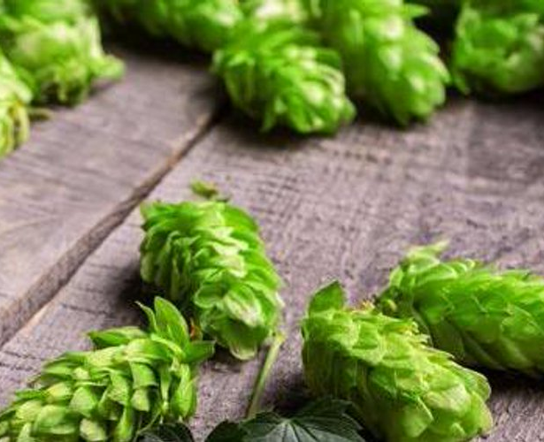
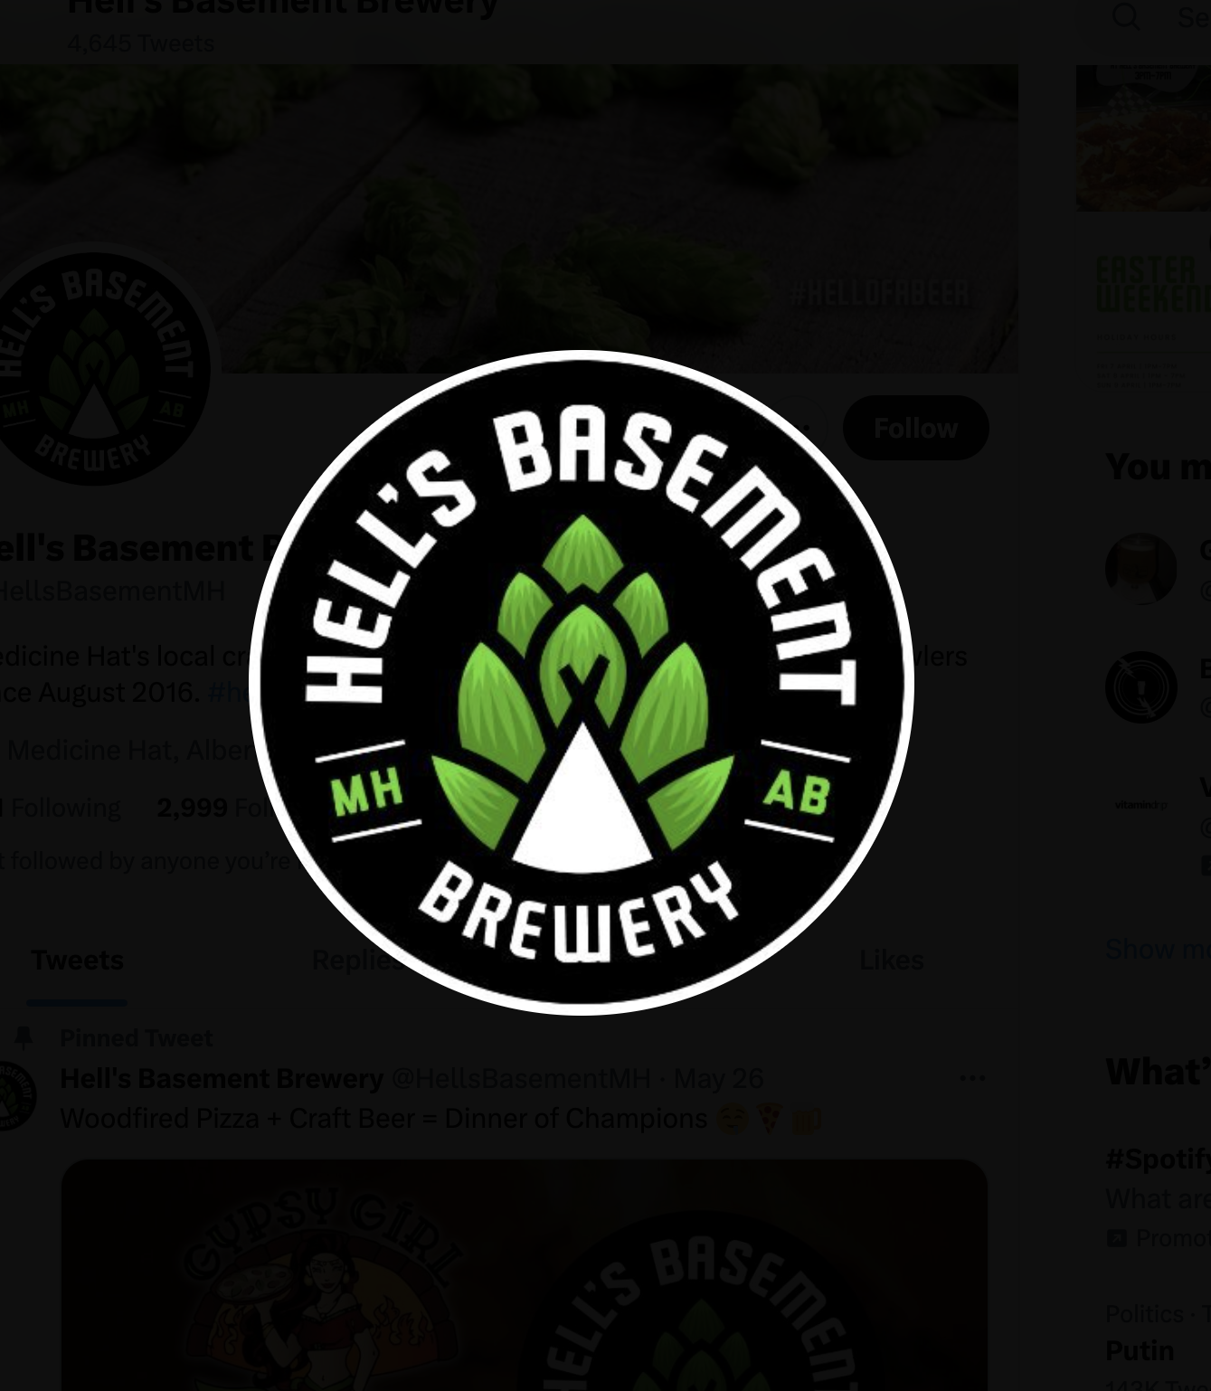

TEAM 6
Jonathan Coutu Runze Liang
Vivek Pereira Runze Xu
Yuchen Zhang

Slide 2

CHALLENGING BUSINESS ENVIRONMENT
The COVID crisis has struck a devastating blow to an industry already reeling from intense competition
The rise in popularity of substitutes products such as wine, cider and liquor causes a decline in beer consumption
Beer often seen as less healthy than wine
Number of breweries increased 12.9% 2018 -2019 and 8% in 2020
Over 100 Class E breweries in Albert
120 craft breweries in Albert and 63% of them opened after 2017
Severe revenue Drop
Second Wave of Covid
61% breweries has cash less than 3 month
65% breweries employee were laid-off

Slide 3
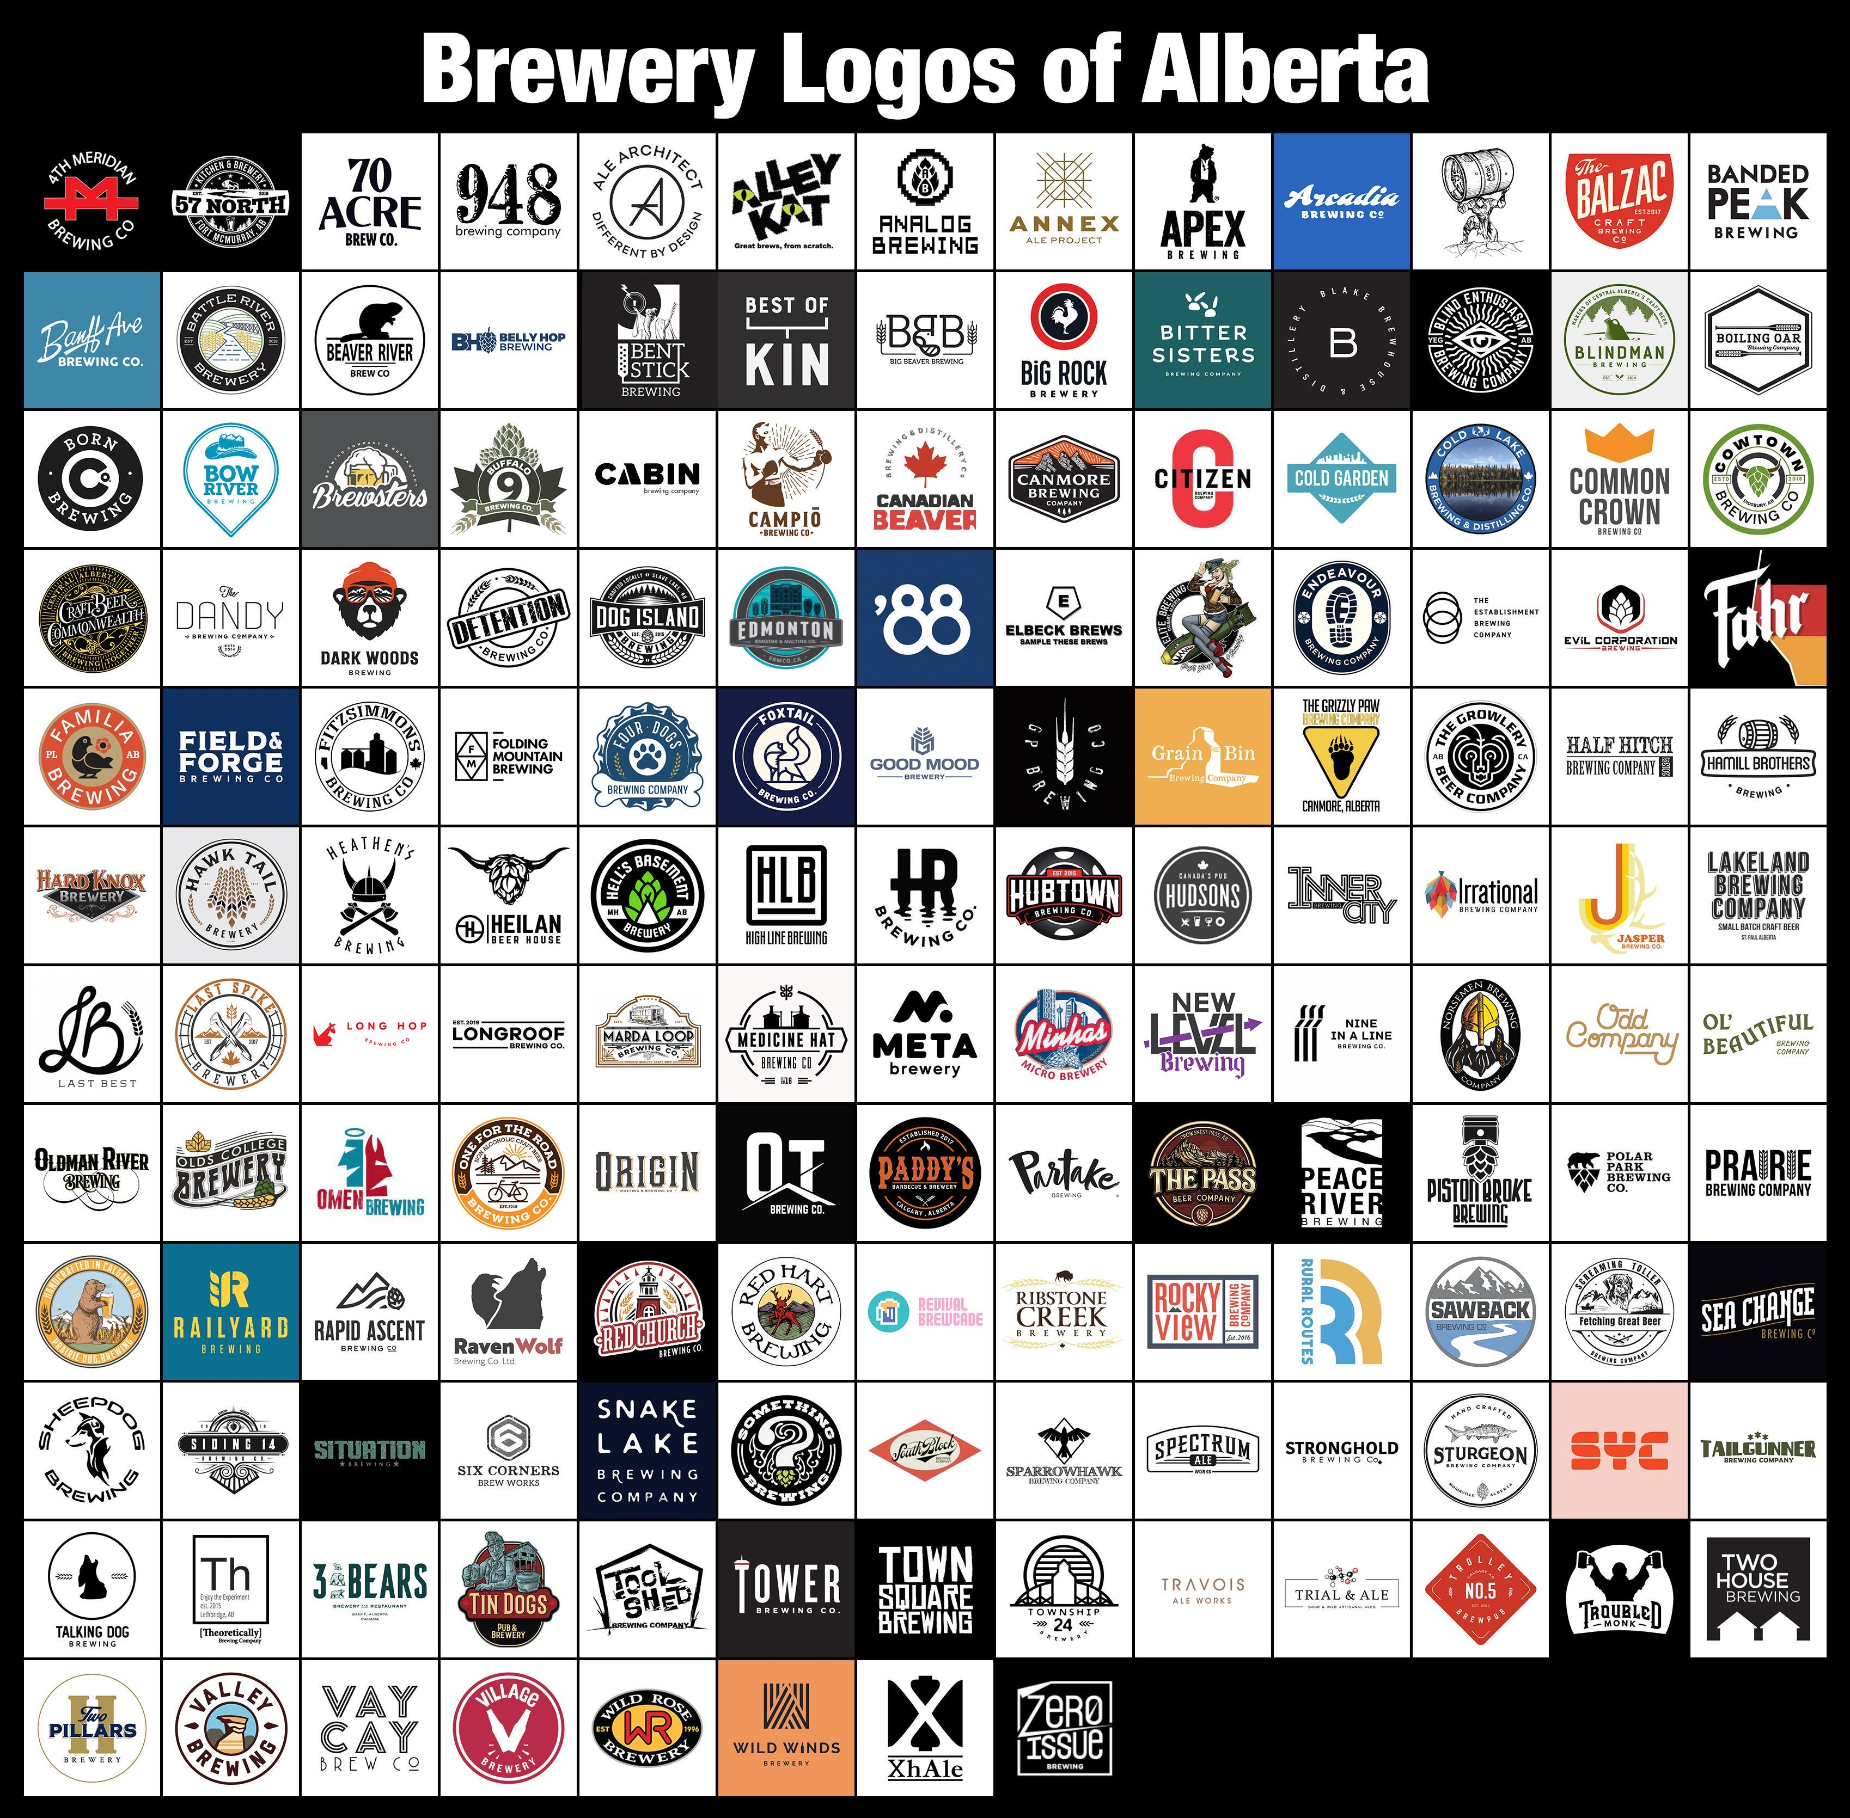

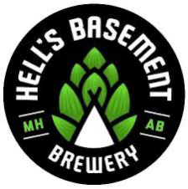
NEW OPPORTUNITY
The Home Beer Delivery Act
During the COVID-19 pandemic, Albterta relaxed its laws to allow for home delivery of alcoholic beverages
NEW REGULATIONS SOMETIMES BRING OPPORTUNITIES

Slide 4

CHALLENGING TIME
Covid caused a collapse in sales, but a recent financial restructuring leaves HBB in strong financial health
Notes:
Citation:
Exhibit 7 provides detailed financial information about Hell's Basement Brewery, including revenue, cost of sales, gross profit, expenses, and net income. Analyzing this exhibit will allow you to assess the financial performance of the brewery over the three-year period and identify any significant changes or trends that may have been influenced by the pandemic.
Exhibit 10 presents the revenue change among Canadian craft breweries from March 2019 to 2020, specifically highlighting the percentage of breweries experiencing various levels of revenue change. This exhibit will provide insights into how the craft brewing industry was impacted by the pandemic and whether Hell's Basement Brewery experienced a similar trend.

Slide 5




PROBLEM IDENTIFICATION
INTENSE RIVALRY FOR TAP LINES IN BARS
SATURATION OF THE SHELF SPACE IN STORE
The increasing competition and the Covid-related uncertainty are compelling HBB to explore new alternative avenues for expanding sales.
LOSS OF OVER HALF THE SALES DUE TO COVID
THREAT OF ANOTHER PAINFUL LOCKDOWN

Slide 6
ALTERNATIVE SOLUTIONS
Fierce competition isn't confined to Medicine Hat – local breweries elsewhere have the powerful advantage of proximity
Home Delivery Model
The non-alcoholic drink battle is fierce, and HBB stands inexperienced amidst the giants
Brew 0% beer
Develop New Line of Craft Soda
Contract brewing another brand fails to generate genuine long-term value and instead invites vulnerability
IMPACT ON SALES
Expand In-House Sales Team
Develop Cold-Brew Coffee
Hire Commercial Agents
Investing into a sales force is a risky move if the goal is to directly confront the fierce competition
Sub-contract manufacturing
Export to Other Provinces
The aim is to sidestep the competition by forging a new distribution channel
EFFORT

Slide 7
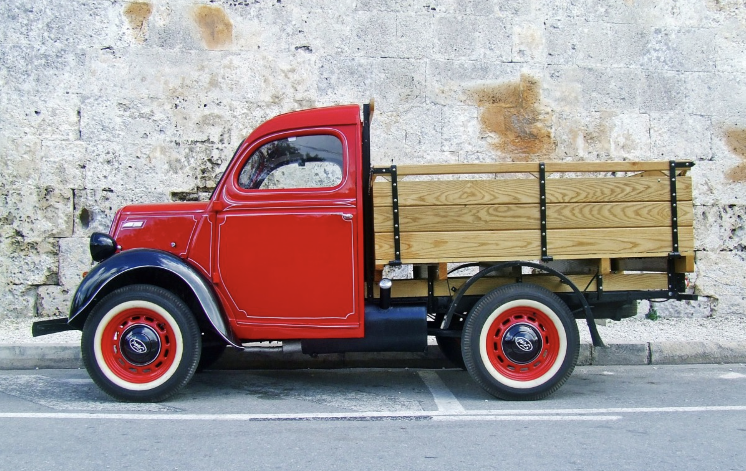
RECOMMENDATION
Crafting Convenience, Delivering Quality: A new beer journey reinvented through online sales and at-home delivery
NEW LAW ON HOME DELIVERY
LOCAL BRAND AWARENESS
EXISTING CLIENTS LOYALTY
DIRECT-TO-CUSTOMER SALES & AT-HOME DELIVERY MODEL

Slide 8






VALUE CREATION
Revolutionizing the Beer Experience: Delivering directly to your doorstep for unprecedented value creation
SALES INCREASE
The new online transactional channel supplements existing distribution with additional sales.
BETTER MARGINS
Direct-to-customer sales allow to bypass intermediaries, thereby capturing a larger share of the value creation
DATA COLLECTION
Online sales and digital marketing enable the creation of a segmented database, which can generate substantial long-term value
BRAND VISIBILITY
Digital marketing and promotional campaigns on social media allow for an increase in brand awareness
CLIENTS DELIGHT
The new delivery service clearly enhances the customer experience, as clients receive their beers directly at home
STREAMLINING
Direct contact with clients provides valuable insights that allow for improvements in operations and inventory management
WE EXPECT ONLINE SALES TO GENERATE UP TO 20% OF SALES IN THE NEXT 2 YEARS

Slide 9
IMPLEMENTATION
Phase 1: Preparation
Phase 2: Execution
Phase 3: Launch
Action | Design an e-commerce platform for online orders: hire a UX/UI designer to design a website that is attractive and easy to use. |  | Train delivery drivers. |  | Determine delivery logistics: determine the number of delivery vehicles and amount of garage space to be purchased. |  |  |  | Build an e-commerce platform for online orders: hire a full stack software engineer to build the website based on the design from the previous phase. |  |  |  | Purchase delivery vehicles & garage space. |  | Run a social media campaign and distribute flyers. The social media campaign should be run through the existing company pages on Facebook, Twitter, and Instagram. Flyers can be distributed across Alberta. |  |  |  |  |  | Review initial launch: analyze the number of visits and units sold through the site.
Cost per phase | $2500 |  | $500 |  | $800 |  |  |  | $8400 |  |  |  | $65000 |  | $600 |  |  |  |  |  | $500
Project Plan | Jun |  | Jul |  | Aug |  | Sep |  | Oct |  | Nov |  | Dec |  | Jan |  | Feb |  | Mar |  | Apr |  | May
Preparation
Execution
Launch

Slide 10
RISK AND MITIGATION
 | Associated Risk | Mitigation Strategy
1 | Website crashes | Hire a software engineer to analyze and fix the issue (strengthen website infrastructure)
2 | Low customer satisfaction | Implement a feedback system to capture and address customer pain points
3 | Low demand for home delivery service | Run a promotion that gives customers a discount on their first online purchase
4 | Inventory management challenges | Closely monitor stock levels and replan stocking schedule accordingly
1
Probability of Occurrence
3
2
4
Negative Impact on Hell’s Basement Brewery

Slide 11
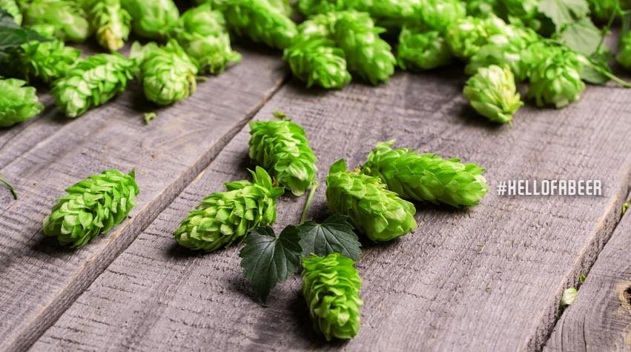
APPENDIX

Slide 12
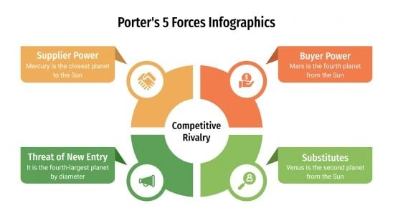
PORTER’S 5 FORCES
SUPPLIER POWER
- Best hops are supplied in limited supply. Advance contract required
- Limited quantities of fresh barrels
BUYER POWER
Government regulations favors large chains
Customers are rarely loyal to brands
Beer geeks are craving for novelties and exclusive products
INTENSE INDUSTRY RIVALRY
THREAT OF NEW ENTRY
- Constant new competitors with nearly 3x more Class E in the past 3 years
- Excess production capacities in the industry makes it easy to launch a new brand by subcontracting the production
THREAT OF SUBSTITUTES
Seltzer is a big trend
Wine, cocktails, whiskey and liquors; plenty of substitutes
Non alcoholised beverage is a big trend
THE MICRO-BREWERY INDUSTRY IS HIGHLY COMPETITIVE

Slide 13
SWOT ANALYSIS
S STRENGHTS
- Well-established brand name in the community being the first to market
- Recent financial restructuring left HBB in better financial shape than other
- Equipment not utilized at full capacity. Possibility to do contract brewing
W WEAKNESSES
- 2020 sales have been cut in half because of Covid
- No differentiation in the product portfolio
- Everybody knows about the business fragility after financial restructuring
- No dedicated sales force and limited marketing spending
O OPPORTUNITIES
- Changes in import/export rules makes it possible to export to other provinces
- Possibility to deliver beer directly at home
- Customers are loyal to their local establishment
T THREATS
- Competition keeps increasing with 100 permits in Alberta, up from 40 only 3 years ago
- Economic downturn associated with the consumption of cheap beer, not craft beer
- Specialized labor shortage due to increase competition
- New tariffs and duties affect costs
- New potential lockdown

Slide 14
ANSOFF MATRIX
MARKET DEVELOPMENT
Expand distribution in Calgary bars and restaurants
Expand distribution in Edmonton bars and restaurants
Grow the retail market in Saskatchewan and Manitoba
DIVERSIFICATION
Launch a new celebrity-sponsored beer to penetrate the market in Calgary and Edmonton
Launch a line of craft cola in national distribution
NEW MARKETS
MARKET PENETRATION
Grow the craft beer market share around Medicine Hat with a new distribution channel
Grow the RTD beverage market around Medicine Hat
PRODUCT DEVELOPMENT
Develop a line of craft cola other than root beer
Develop a line of cold-brew coffee in cans
Develop non-alcoholised beer
EXISTING MARKETS
EXISTING PRODUCTS
NEW PRODUCTS

Slide 15
Aspect | Valuable | Rare | Inimitable | Organizational
Strong local customer base | Yes | No | No | No
Ability to brew own beer | Yes | No | No | No
Tangible sales in nearby locations | Yes | No | No | No
Past government support | Yes | Yes | Yes | No
Online presence | Yes | Yes | No | No
Potential for contract brewing | Yes | Yes | No | No
Notes:
VRIO Analysis:
Strong local customer base: This is considered valuable as it indicates a dedicated clientele, which can contribute to stable sales and repeat business.
Ability to brew own beer: Brewing own beer provides control over the brewing process and product quality, which can be a competitive advantage in the craft beer industry.
Tangible sales in nearby locations: The ability to generate sales outside the local city demonstrates the potential for expanding customer reach and capturing market share.
Past government support: The previous receipt of wage subsidies and a loan from CERB during the pandemic can be considered rare and valuable resources, as it indicates access to financial assistance during challenging times.
Online presence: Having a presence on social media platforms and a company website is valuable as it provides channels for promotion, engagement with customers, and reaching a wider audience.
Potential for contract brewing: The opportunity to engage in contract brewing can be a valuable resource, as it allows the brewery to increase production capabilities and leverage professional facilities.
In terms of inimitability, while the strong local customer base and tangible sales can be imitated by competitors, the brewing capability and potential for contract brewing may be harder to replicate.
However, the analysis also identifies some organizational aspects that can be improved. The lack of a dedicated sales force and limited marketing spending are weaknesses that may hinder the brewery's capabilities to fully leverage its strengths and opportunities.

Slide 16
Internal Environment
Strengths | Weaknesses
- Retained dedicated local customer base and generated tangible sales (43.90% revenue decrease >50%) | - Limited sales growth outside local city (10.40% revenue decrease <25%)
- Maintained sales with online presence and past government support (8.70% no change in revenue) | - Limited marketing spending (3.50% revenue increase 25-50%, 3.80% revenue increase >50%)
VRIO Analysis
Valuable: Local customer base and tangible sales (43.90% revenue decrease >50%)
Rare: A small percentage of breweries (3.5% & 3.8%) reported revenue raise of 25% to 50%, and more than 50%
Inimitable: Difficulty replicating local customer base and tangible sales
Organizational: Lack of dedicated sales force and limited marketing aligns with industry data showing limited revenue growth
Notes:
Strengths:
Hell's Basement Brewery's ability to retain a dedicated local customer base and generate tangible sales aligns with the data showing a 43.90% of breweries experiencing a revenue decrease of more than 50%.
The brewery's online presence and past government support may have contributed to their ability to maintain sales, as evidenced by the 8.70% of breweries reporting no change in revenue.
Weaknesses:
The data shows that 10.40% of breweries experienced a revenue decrease of less than 25%, highlighting the challenge faced by Hell's Basement Brewery in limited sales growth outside the local city.
The limited marketing spending of Hell's Basement Brewery is reflected in the industry data, where breweries that experienced revenue increases of 25% to 50% and more than 50% account for only 3.50% and 3.80% respectively.
VRIO
Valuable: The significant percentage (43.90%) of breweries experiencing a revenue decrease of more than 50% indicates that Hell's Basement Brewery's local customer base and tangible sales are valuable assets.
Rare: The data reveals that only a small percentage of breweries (3.50% and 3.80%) reported revenue increases of 25% to 50% and more than 50%, respectively. This rarity aligns with the potential for Hell's Basement Brewery to leverage its brewing capabilities and local presence to achieve growth in a challenging market.
Inimitable: The industry-wide revenue decreases and limited sales growth indicate that replicating Hell's Basement Brewery's strong local customer base and tangible sales may be difficult for competitors.
Organizational: The lack of a dedicated sales force and limited marketing spending identified in the internal analysis aligns with the industry data, where a small percentage of breweries reported significant revenue increases.

Slide 17
